Slide 1
Parvoviridae
Latin parvus or parvum, meaning small or tiny, referring to the small size of parvovirus virions

Slide 2
Parvoviruses
Virus classification
Group: | Group II (ssDNA)
Family: | Parvoviridae
Subfamilies
Densovirinae (Viruses of insects)- Densovirus, Iteravirus, Contravirus Parvovirinae- Parvovirus (Feline panleukopenia,Canine parvovirus) Erythrovirus, Dependovirus (Adeno Associated Virus)

Slide 3
Morphology
Non-enveloped, 25 nm in diameter, and have icosahedral symmetry.
The surface features of the capsid revealed by X-ray crystallography include a hollow cylinder at each fivefold axis of symmetry that is surrounded by a circular depression (called the canyon).
The capsid is composed of 60 molecules of VP2 protein, along with a few molecules of VP1. VP1 and VP2 are formed by alternative splicing of the same mRNA, and the entire sequence of VP2 is encoded within the VP1 gene.
A third structural protein, VP3, is formed only in "full" (DNA-containing) capsids by cleavage of 15-20 amino acids from the amino terminus of VP2.
VP2 is the most immunogenic.

Slide 4
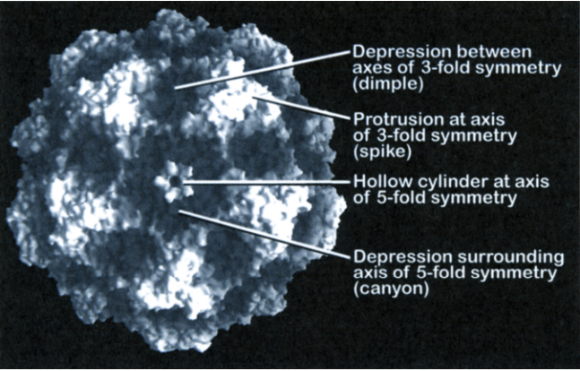
Capsid confers much stability upon the virus particles, allowing for resistance to inactivation by pH, solvents, or temperatures up to 50 degrees C. Parvoviruses are thus among the most resistant viruses known.

Slide 5
Genome
The genome consists of a single molecule of linear single-stranded DNA, 5.2 kb in size.
Some parvoviruses encapsidate only the negative-sense or antisense DNA strand (e.g., canine parvovirus 2, minute virus of mice), whereas others encapsidate different proportions of either strand.
The genome has 6 to 10 terminal palindromic sequences, enabling each end to form hairpin structures.
Replication occurs in the nucleus of dividing cells; infection leads to large intranuclear inclusion bodies
Most viruses hemagglutinate red blood cells
Notes:
Negative sense DNA or antisense DNA is a strand that is complementary to mRNA i.e. from this strand mRNA is formed.
Positive sense DNA or Sense DNA is a strand i.e. is similar to that of mRNA. Sense strand looks like mRNA but cannot form mRNA.

Slide 6
Viral Replication
Viral replication takes place in the nucleus and requires host cell functions of late S phase (i.e. period of DNA replication) or early G2 phase (i.e. The stage of cell cycle between the end of DNA synthesis and beginning of mitosis) of the cell division cycle.
This requirement for cycling cells for viral replication is the basis for many aspects of the pathogenesis of parvovirus infections.
Specifically, there is no polymerase enzyme in the virion itself nor does the virus encode any such enzyme.
Instead, cellular DNA polymerase II is employed to transcribe viral DNA into a double stranded DNA intermediate, which is then used as a template as other cellular enzymes catalyze the transcription of viral mRNAs.

Slide 7
Viral Replication
The viral ssDNA genome penetrates into the nucleus.
The ssDNA is converted into dsDNA by cellular proteins.
dsDNA transcription gives rise to viral mRNAs when host cell enters S phase and translated to produce viral proteins.
Replication occurs through rolling-hairpin mechanism, with NS1 endonuclease binding covalently to the 5' genomic end.
Individual ssDNA genomes are excised from replication concatemers.
These newly synthesized ssDNA can either
a) be converted to dsDNA and serve as a template for transcription/replication
b) be encapsidated to form new virions that are released by cell lysis.

Slide 8
Viral Replication
Cellular DNA dependent RNA polymerase synthesizes three mRNA.
These mRNA have a common 3’ terminus.
Most abundant mRNA which is encoded in the 3'-half of the genome, codes for structural proteins (VP1and VP2) late in infection.
The non structural (NS1) proteins involved in DNA replication reside in left half, the 5'-half, of DNA.

Slide 9
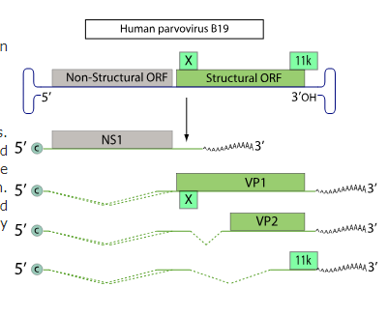

Slide 10
The nonstructural protein (NS1), is also produced in very large amounts and serves a number of functions:
(1) it binds to DNA and is required for viral DNA replication,
(2) it serves as a helicase,
(3) it serves as an endonuclease
(4) it interferes with cellular DNA replication by producing nicks in cellular DNA.
This latter activity leads to the arrest of the cell division cycle in S phase.

Slide 11
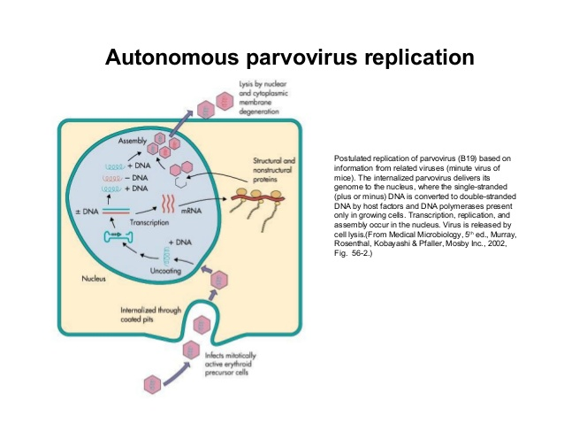

Slide 12
Canine Parvovirus

Slide 13
History
There are two types of canine parvovirus called canine minute virus (CPV1) and CPV2.
CPV2 causes the most serious disease and affects domesticated dogs and wild canids.
Variants of CPV type 2 - CPV-2a, CPV-2b and CPV-2c. The antigenic patterns of 2a and 2b are quite similar to the original CPV type 2. Variant 2c however has a unique pattern of antigenicity.
CPV2 virus is very similar to feline panleukopenia virus; they are 98% identical, differing only in two amino acids in the viral capsid protein VP2 (determinant of Host range difference).
The canine virus can replicate in both canine and feline cells but the feline virus replicates only in feline cells.
It is also highly similar to mink enteritis, and the parvoviruses of raccoons and foxes.

Slide 14
Three distinct age-related canine parvovirus disease syndromes have been recognized in dogs.
1. The generalized neonatal disease syndrome- rare.
2. The myocarditis syndrome is usually recognized in pups by sudden death, usually without preceding clinical signs. Even though damage to the myocardium may be extensive, some pups may survive with lifelong cardiac problems.
Seen in pups at 4 to 8 weeks of age and was common when the virus first emerged in 1978-1979.
Widespread use of vaccine and its induction or boosting of maternal antibody has made the generalized neonatal disease syndrome and the myocarditis syndrome less common.

Slide 15
3. The leukopenia/enteritis syndrome parallels that seen in cats –feline panleukopenia or feline distemper.
The incidence of the leukopenia/enteritis syndrome has fallen since the virus first emerged, but is still an important cause of morbidity.
Most commonly in pups at 8 to 12 weeks of age.
Vomiting is often the initial sign and can be severe and protracted. There is anorexia, lethargy, and diarrhea leading to rapid dehydration.
The feces are often streaked with blood or frankly hemorrhagic and remain fluid until recovery or death.
Death is uncommon except in young pups.

Slide 16
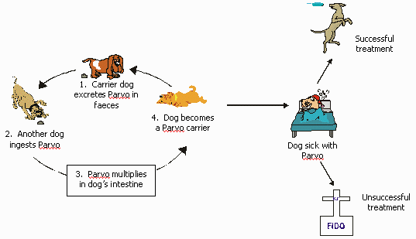
Life cycle of Parvovirus

Slide 17
Pathogenesis
Following viral entry in the oropharynx, initial viral replication occurs in pharyngeal lymphoid tissue.
From here the virus is distributed to other organs and tissues via the bloodstream.
Cells that have appropriate receptors and are in the S phase of the cell cycle are infected and killed or prevented from entering mitosis.
The characteristic profound leukopenia involves all white blood cell elements: lymphocytes, neutrophils, monocytes, and platelets.
These cells are destroyed, both those present in the circulation and those in lymphoid organs, including the thymus, bone marrow, lymph nodes, spleen, and Peyer's patches.
Resting peripheral leukocytes may be stimulated to proliferate, thereby becoming permissive for viral replication.
Alternatively, the presence of virus bound to the surface of cells may render them targets for cytotoxic lysis.

Slide 18
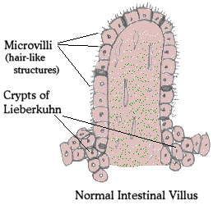
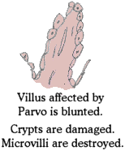
Hemorrhagic enteritis
Villi become blunt and unable to absorb nutrients.
Barrier to GIT flora is broken down.

Slide 19
Rapidly dividing intestinal epithelial cells in the crypts of Lieberkuhn are very susceptible to infection.
The loss of cells from villus tips continues in normal fashion, but the failure in replacing these cells with cells from the crypts leads to greatly shortened, no absorptive villi and hence to diarrhea.
At all ages, the continuous division of cells in lymphoid tissues and the intestinal epithelium leads to the common occurrence of leukopenia and enteritis.

Slide 20
Mechanisms of Death
Diarrhea and vomiting
  →extreme dehydration → SHOCK
Loss of intestinal barrier
→ bacterial invasion → SEPTIC SHOCK

Slide 21
Clinical features
Fever, lethargy, anorexia
Vomiting
Diarrhea: watery, bloody, with a tell-tale odor
Severely dehydrated

Slide 22
Diagnosis
History and PE
Clinical signs
Haemagglutination of pig and rhesus monkey RBC by virus present in fecal extracts.
Electron microscopy, virus isolation, enzyme immunoassay, and amplification of viral DNA using PCR
Biopsy
Necropsy
  Lower and middle small intestines
  Bone marrow

Slide 23
Prognosis
Most recover with intensive therapy
Dobermans and Rottweilers
  Sensitive to the virus
Poor prognosis
  Intussusception
  Hypoproteinemia
  No improvement after 4th day of intensive care

Slide 24
Protection
Colostrum
  Maternal antibodies protective until 2 month of age
Regular Vaccination
Keep indoors
  Until the vaccination series are complete
  Immunity after natural infection appears to be lifelong.

Slide 25
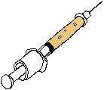
CPV Vaccine History
Original vaccines incorporated feline panleukopenia virus or mink enteritis viruses
  Similar to the original CPV
Killed and MLV were developed, but variable efficacy
  Low titer
  Interference of Maternal antibodies

Slide 26
Vaccines
    The DHPP vaccine, also known as the 5-in-1 vaccine, protects dogs against five highly contagious viral diseases that cause severe illness and may be fatal: distemper, canine adenovirus-1 (CAV-1), canine adenovirus-2 (CAV-2), parainfluenza, and parvovirus.
    Other abbreviations for the vaccine are DA2PP and DAPP.
    Nobivac® DHPPi
    Live attenuated vaccine for immunization of dogs against canine distemper virus, canine adenovirus, canine parvovirus and canine parainfluenza virus

Slide 27
CPV Vaccination Recommendations
Use modified live vaccines for puppies
Start vaccinations at 6-8 weeks of age
Vaccinate every 3-4 weeks until 15-16 weeks of age
  Giving a vaccine more frequently than every 2 weeks will cause interference
  This includes vaccines for different infections

Slide 28
Other Parvoviruses…
Feline Panleukopenia Virus
Porcine Parovirus
Aleutian Mink Diseases

